Slide 1

Essentials
with Spring Cloud Stream

Slide 2
Intro to Apache Kafka
✳️What is Kafka and why use it?
✳️Kafka and event-driven microservices
✳️Kafka architecture: brokers, topics, partitions, producers, consumers

Slide 3
What is Apache Kafka?
Kafka is a tool that helps apps send and receive messages in real-time, making it easier to build fast and reliable systems.

Slide 4
What is Apache Kafka?
Kafka is a tool that helps apps send and receive messages in real-time, making it easier to build fast and reliable systems.

Slide 5

What is Apache Kafka?
Kafka is a tool that helps apps send and receive messages in real-time, making it easier to build fast and reliable systems.
*real-time = data is sent, received, and processed almost immediately, as soon as it's available

Slide 6
What is Apache Kafka?
Kafka is a tool that helps apps send and receive messages in real-time, making it easier to build fast and reliable systems.

Slide 7

What is Apache Kafka?
Kafka is a tool that helps apps send and receive messages in real-time, making it easier to build fast and reliable systems.
*asynchronous processing = sends and receives messages
without waiting others to finish, allowing things to happen in parallel.
(async)
(sync)

Slide 8
What is Apache Kafka?
Kafka is a tool that helps apps send and receive messages in real-time, making it easier to build fast and reliable systems.

Slide 9
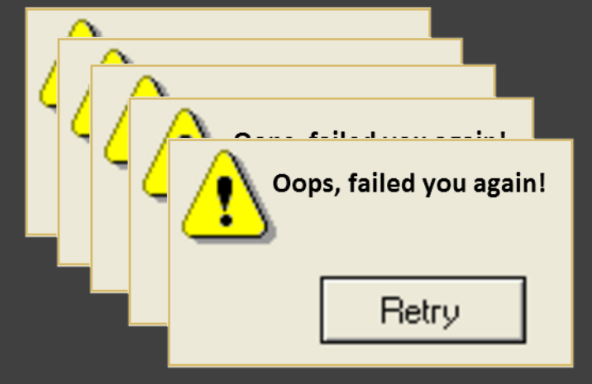
What is Apache Kafka?
Kafka is a tool that helps apps send and receive messages in real-time, making it easier to build fast and reliable systems.
*reliable = it stores messages on disk,
replicates them across multiple servers,
guarantees delivery even if some parts of the system fail

Slide 10
Kafka and Event-Driven Microservices
✅What is Kafka and why use it?
✳️Kafka and event-driven microservices
✳️Kafka architecture: brokers, topics, partitions, producers, consumers

Slide 11

Kafka in Event-Driven Microservices
Portfolio Service
update portfolio
places an order
Order Execution Service
User

Slide 12
Kafka in Event-Driven Microservices
Portfolio Service
update portfolio
places an order
Order Execution Service
improve data & analytics
Analytics Service
User

Slide 13
Kafka in Event-Driven Microservices
Portfolio Service
update portfolio
places an order
Order Execution Service
improve data & analytics
Analytics Service
notify user
Notification Service
User

Slide 14
Kafka in Event-Driven Microservices
Portfolio Service
Order Execution Service
Analytics Service
Notification Service
User

Slide 15
Kafka in Event-Driven Microservices
Portfolio Service
order.placed
Order Execution Service
Analytics Service
Notification Service
User

Slide 16
Kafka in Event-Driven Microservices
Portfolio Service
order.placed
Order Execution Service
order.executed
Analytics Service
Notification Service
User

Slide 17
Kafka in Event-Driven Microservices
Portfolio Service
updates portfolio
order.placed
Order Execution Service
order.executed
Analytics Service
Notification Service
User

Slide 18
Kafka in Event-Driven Microservices
Portfolio Service
updates portfolio
order.placed
Order Execution Service
order.executed
Analytics Service
improves data & analytics
Notification Service
User

Slide 19
Kafka in Event-Driven Microservices
Portfolio Service
updates portfolio
order.placed
Order Execution Service
order.executed
Analytics Service
improves data & analytics
Notification Service
User
notifies user

Slide 20
Intro to Apache Kafka
✅What is Kafka and why use it?
✅Kafka and event-driven microservices
✳️Kafka architecture: brokers, topics, partitions, producers, consumers

Slide 21
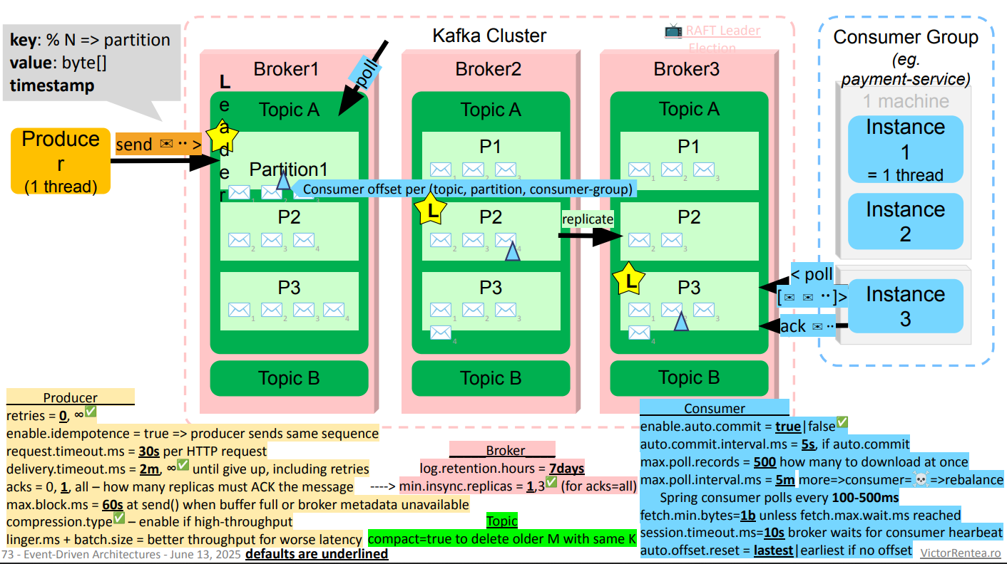
Goal of the Course: Understand this Image

Slide 22

Kafka Architecture
Kafka Cluster
Producer 1
Topic A - partition 0
Consumer 1
Topic A - partition 1
Producer 2
Consumer 2
push
poll
✉️✉️✉️✉️
Producer 3
Topic N
offset: 3 2 1 0
Consumer 3
Broker 1
. . .
. . .
Broker 2
Consumer n
Producer n
Broker 3

Slide 23
Kafka Architecture
Producer 1
Producer 2
push
Producer 3
. . .
Producer n

Slide 24
Kafka Architecture
Kafka Cluster
Producer 1
Producer 2
push
Producer 3
. . .
Producer n

Slide 25
Kafka Architecture
Kafka Cluster
Producer 1
Consumer 1
Producer 2
Consumer 2
push
poll
Producer 3
Consumer 3
. . .
. . .
Producer n
Consumer n

Slide 26
Kafka Architecture - The Brokers
Kafka brokers are servers
with local storage that reliably manage and store topic partitions.
They ensure durable data flow between producers and consumers.
Kafka Cluster
Broker 1
Broker 2
Broker 3

Slide 27

Kafka Architecture - The Brokers
Kafka brokers are servers
with local storage that reliably manage and store topic partitions.
They ensure durable data flow between producers and consumers.
Kafka Cluster
Broker 1
Broker 2
Broker 3

Slide 28
Kafka Architecture - The Brokers
Kafka brokers are servers
with local storage that reliably manage and store topic partitions.
They ensure durable data flow between producers and consumers.
Kafka Cluster
✉️✉️✉️✉️
Topics
Broker 1
Broker 2
Broker 3

Slide 29
Exercise: Use Kafka UI to see the Kafka brokers in your scrum environment

Slide 30
Kafka Architecture - The Topics
A Kafka topic is a stream of messages divided into partitions.
Each message has a unique offset that marks its position in the partition.
Topic A
✉️✉️✉️

Slide 31
Kafka Architecture - The Topics
A Kafka topic is a stream of messages divided into partitions.
Each message has a unique offset that marks its position in the partition.
Topic A
✉️✉️✉️
partition 0
✉️✉️✉️✉️
partition 1

Slide 32
Kafka Architecture - The Topic Partitions
A Kafka topic is a stream of messages divided into partitions.
Each message has a unique offset that marks its position in the partition.
Topic A
✉️✉️✉️
partition 0
2 1 0
✉️✉️✉️✉️
partition 1
3 2 1 0

Slide 33
Kafka Architecture - The Topic Partitions
The message key decides which partition a message goes to.
Helping distribute data evenly and maintain order for messages with the same key.
Topic A
✉️✉️✉️
partition 0
✉️✉️✉️✉️
partition 1

Slide 34
Kafka Architecture - The Topic Partitions
The message key decides which partition a message goes to.
Helping distribute data evenly and maintain order for messages with the same key.
Topic A
✉️✉️✉️
partition 0
✉️✉️✉️✉️
partition 1
messages are immutable (we cannot rewrite history)

Slide 35
Kafka Architecture - The Topic Partitions
Topic A
partition 0
✉️✉️✉️✉️
partition 1
message keys 6005 5612 5501 6005 (eg: accountID)
partition 2

Slide 36
Kafka Architecture - The Topic Partitions
Topic A
partition 0
✉️✉️✉️✉️
partition 1
message keys 6005 5612 5501 6005 (eg: accountID)
partition 2

Slide 37
Kafka Architecture - The Topic Partitions
message key = 6005
Topic A
partition 0
✉️✉️✉️✉️
partition 1
message keys 6005 5612 5501 6005 (eg: accountID)
partition 2

Slide 38
Kafka Architecture - The Topic Partitions
message key = 6005 no. of partitions = 3
Topic A
partition 0
✉️✉️✉️✉️
partition 1
message keys 6005 5612 5501 6005 (eg: accountID)
partition 2

Slide 39
Kafka Architecture - The Topic Partitions
message key = 6005 no. of partitions = 3 partition = 6005 % 3 = 2
Topic A
partition 0
✉️✉️✉️✉️
partition 1
message keys 6005 5612 5501 6005 (eg: accountID)
partition 2

Slide 40
Kafka Architecture - The Topic Partitions
Topic A
partition 0
✉️✉️✉️
partition 1
message keys 6005 5612 5501 (eg: accountID)
✉️
partition 2
6005

Slide 41
Kafka Architecture - The Topic Partitions
message key = 5501 no. of partitions = 3 partition = 5501 % 3 = 1
Topic A
partition 0
✉️✉️✉️
partition 1
message keys 6005 5612 5501 (eg: accountID)
✉️
partition 2
6005

Slide 42
Kafka Architecture - The Topic Partitions
message key = 5501 no. of partitions = 3 partition = 5501 % 3 = 1
Topic A
partition 0
✉️✉️
✉️
partition 1
message keys 6005 5612 (eg: accountID)
5501
✉️
partition 2
6005

Slide 43
Exercise: Use Kafka UI to publish a message to a topic. Send another one to a different partition.

Slide 44
Kafka Architecture - The Consumers
Topic A
✉️✉️✉️
partition 0
consumer group
✉️✉️✉️✉️
partition 1
Consumer 1
✉️✉️
partition 2

Slide 45
Kafka Architecture - The Consumers
Topic A
✉️✉️✉️
partition 0
consumer group
✉️✉️✉️✉️
partition 1
Consumer 1
✉️✉️
partition 2

Slide 46
Kafka Architecture - The Consumers
Topic A
✉️✉️✉️
partition 0
consumer group
partition 1
Consumer 1
✉️✉️✉️✉️
Consumer 2
✉️✉️
partition 2

Slide 47
Kafka Architecture - The Consumers
Topic A
✉️✉️✉️
partition 0
consumer group
partition 1
Consumer 1
✉️✉️✉️✉️
Consumer 2
✉️✉️
partition 2

Slide 48
Kafka Architecture - The Consumers
Topic A
✉️✉️✉️
partition 0
consumer group
Consumer 1
✉️✉️✉️✉️
partition 1
Consumer 2
Consumer 3
✉️✉️
partition 2

Slide 49
Kafka Architecture - The Consumers
Topic A
✉️✉️✉️
partition 0
consumer group
Consumer 1
✉️✉️✉️✉️
partition 1
Consumer 2
Consumer 3
✉️✉️
partition 2

Slide 50
Kafka Architecture - The Consumers
Topic A
consumer group
partition 0
Consumer 1
✉️✉️✉️
Consumer 2
✉️✉️✉️✉️
partition 1
Consumer 3
Consumer 4
✉️✉️
partition 2
Consumer 5

Slide 51
Kafka Architecture - The Consumers
Topic A
consumer group
partition 0
Consumer 1
✉️✉️✉️
Consumer 2
✉️✉️✉️✉️
partition 1
Consumer 3
Consumer 4
✉️✉️
partition 2
Consumer 5

Slide 52
Kafka Architecture - The Consumers
Topic A
consumer group
partition 0
Consumer 1
✉️✉️✉️
Consumer 2
✉️✉️✉️✉️
partition 1
Consumer 3
Consumer 4
✉️✉️
partition 2
Consumer 5

Slide 53
Kafka Architecture - The Consumers
Topic A
consumer group
partition 0
Consumer 1
✉️✉️✉️
Consumer 2
✉️✉️✉️✉️
partition 1
Consumer 3
Consumer 4
✉️✉️
partition 2
Consumer 5

Slide 54
Kafka Architecture - The Consumers
Topic A
consumer group
partition 0
Consumer 1
✉️✉️✉️
Consumer 2
✉️✉️✉️✉️
partition 1
Consumer 3
🥱
Consumer 4
✉️✉️
partition 2
😴
Consumer 5

Slide 55
Intro to Apache Kafka
✅What is Kafka and why use it?
✅Kafka and event-driven microservices
✅Kafka architecture: brokers, topics, partitions, producers, consumers

Slide 56
Recap
Producer:

Slide 57
Recap
Producer: A client that sends (publishes) messages to Kafka topics.

Slide 58
Recap
Producer: A client that sends (publishes) messages to Kafka topics.
Message:

Slide 59
Recap
Producer: A client that sends (publishes) messages to Kafka topics.
Message: A piece of data (record) sent from a producer to a topic in Kafka.

Slide 60
Recap
Producer: A client that sends (publishes) messages to Kafka topics.
Message: A piece of data (record) sent from a producer to a topic in Kafka.
Message Key:

Slide 61
Recap
Producer: A client that sends (publishes) messages to Kafka topics.
Message: A piece of data (record) sent from a producer to a topic in Kafka.
Message Key: An optional identifier used to determine which partition a message is sent to.

Slide 62
Recap
Producer: A client that sends (publishes) messages to Kafka topics.
Message: A piece of data (record) sent from a producer to a topic in Kafka.
Message Key: An optional identifier used to determine which partition a message is sent to.
Broker:

Slide 63
Recap
Producer: A client that sends (publishes) messages to Kafka topics.
Message: A piece of data (record) sent from a producer to a topic in Kafka.
Message Key: An optional identifier used to determine which partition a message is sent to.
Broker: A Kafka server that stores and serves messages to producers and consumers.

Slide 64
Recap
Producer: A client that sends (publishes) messages to Kafka topics.
Message: A piece of data (record) sent from a producer to a topic in Kafka.
Message Key: An optional identifier used to determine which partition a message is sent to.
Broker: A Kafka server that stores and serves messages to producers and consumers.
Topic:

Slide 65
Recap
Producer: A client that sends (publishes) messages to Kafka topics.
Message: A piece of data (record) sent from a producer to a topic in Kafka.
Message Key: An optional identifier used to determine which partition a message is sent to.
Broker: A Kafka server that stores and serves messages to producers and consumers.
Topic: A logical channel in Kafka to which messages are published and from which they are consumed.

Slide 66
Recap
Producer: A client that sends (publishes) messages to Kafka topics.
Message: A piece of data (record) sent from a producer to a topic in Kafka.
Message Key: An optional identifier used to determine which partition a message is sent to.
Broker: A Kafka server that stores and serves messages to producers and consumers.
Topic: A logical channel in Kafka to which messages are published and from which they are consumed.
Partition:

Slide 67
Recap
Producer: A client that sends (publishes) messages to Kafka topics.
Message: A piece of data (record) sent from a producer to a topic in Kafka.
Message Key: An optional identifier used to determine which partition a message is sent to.
Broker: A Kafka server that stores and serves messages to producers and consumers.
Topic: A logical channel in Kafka to which messages are published and from which they are consumed.
Partition: A sub-division of a topic that allows Kafka to scale and parallelize data.

Slide 68
Recap
Producer: A client that sends (publishes) messages to Kafka topics.
Message: A piece of data (record) sent from a producer to a topic in Kafka.
Message Key: An optional identifier used to determine which partition a message is sent to.
Broker: A Kafka server that stores and serves messages to producers and consumers.
Topic: A logical channel in Kafka to which messages are published and from which they are consumed.
Partition: A sub-division of a topic that allows Kafka to scale and parallelize data.
Offset:

Slide 69
Recap
Producer: A client that sends (publishes) messages to Kafka topics.
Message: A piece of data (record) sent from a producer to a topic in Kafka.
Message Key: An optional identifier used to determine which partition a message is sent to.
Broker: A Kafka server that stores and serves messages to producers and consumers.
Topic: A logical channel in Kafka to which messages are published and from which they are consumed.
Partition: A sub-division of a topic that allows Kafka to scale and parallelize data.
Offset: A unique ID for each message within a partition that indicates its position.

Slide 70
Recap
Producer: A client that sends (publishes) messages to Kafka topics.
Message: A piece of data (record) sent from a producer to a topic in Kafka.
Message Key: An optional identifier used to determine which partition a message is sent to.
Broker: A Kafka server that stores and serves messages to producers and consumers.
Topic: A logical channel in Kafka to which messages are published and from which they are consumed.
Partition: A sub-division of a topic that allows Kafka to scale and parallelize data.
Offset: A unique ID for each message within a partition that indicates its position.
Consumer:

Slide 71
Recap
Producer: A client that sends (publishes) messages to Kafka topics.
Message: A piece of data (record) sent from a producer to a topic in Kafka.
Message Key: An optional identifier used to determine which partition a message is sent to.
Broker: A Kafka server that stores and serves messages to producers and consumers.
Topic: A logical channel in Kafka to which messages are published and from which they are consumed.
Partition: A sub-division of a topic that allows Kafka to scale and parallelize data.
Offset: A unique ID for each message within a partition that indicates its position.
Consumer: A client that reads messages from Kafka topics.

Slide 72
Recap
Producer: A client that sends (publishes) messages to Kafka topics.
Message: A piece of data (record) sent from a producer to a topic in Kafka.
Message Key: An optional identifier used to determine which partition a message is sent to.
Broker: A Kafka server that stores and serves messages to producers and consumers.
Topic: A logical channel in Kafka to which messages are published and from which they are consumed.
Partition: A sub-division of a topic that allows Kafka to scale and parallelize data.
Offset: A unique ID for each message within a partition that indicates its position.
Consumer: A client that reads messages from Kafka topics.
Consumer Group ID:

Slide 73
Recap
Producer: A client that sends (publishes) messages to Kafka topics.
Message: A piece of data (record) sent from a producer to a topic in Kafka.
Message Key: An optional identifier used to determine which partition a message is sent to.
Broker: A Kafka server that stores and serves messages to producers and consumers.
Topic: A logical channel in Kafka to which messages are published and from which they are consumed.
Partition: A sub-division of a topic that allows Kafka to scale and parallelize data.
Offset: A unique ID for each message within a partition that indicates its position.
Consumer: A client that reads messages from Kafka topics.
Consumer Group ID: An identifier for a group of consumers that share the load of reading from topics.

Slide 74
Kafka Architecture
Kafka Cluster
Producer 1
Topic A - partition 0
Consumer 1
Topic A - partition 1
Producer 2
Consumer 2
push
poll
✉️✉️✉️✉️
Producer 3
Topic N
offset: 3 2 1 0
Consumer 3
Broker 1
. . .
. . .
Broker 2
Consumer n
Producer n
Broker 3

Slide 75
Further Reading
Apache Kafka 101 - Confluent Developer

